Slide 1
Convex and Concave Closures

Slide 2
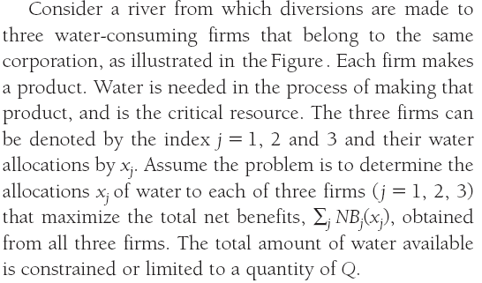
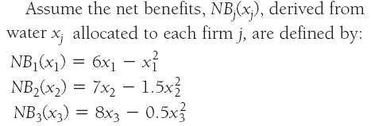

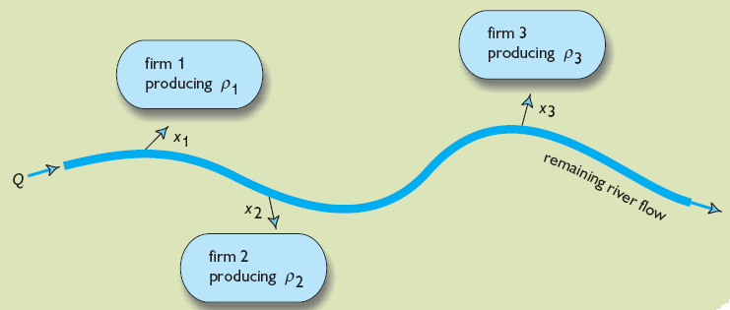
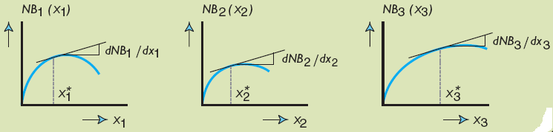
IV. Nonlinear Programming
A nonlinear programming example
x₁+x₂+x₃ ≤ Q
x₁，x₂，x₃ ≥ 0

Slide 3
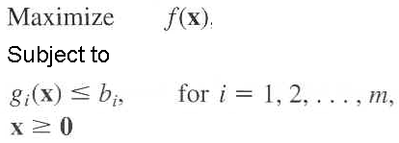
In one general form, the nonlinear programming problem is to find x = (x₁, x₂, …, x_{n}) so as to
Many types of nonlinear programming problems.
Different algorithms for different programming problems.

Slide 4
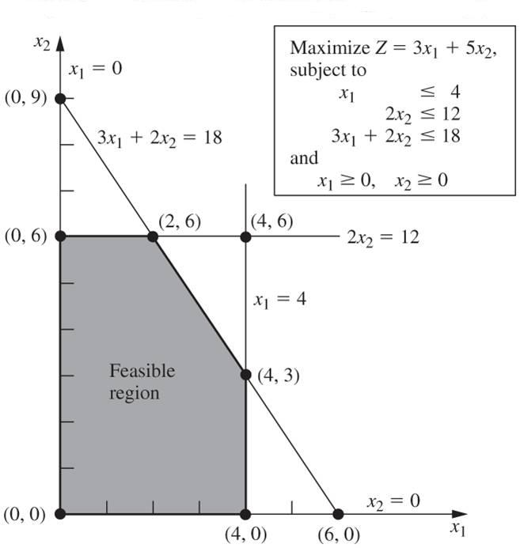
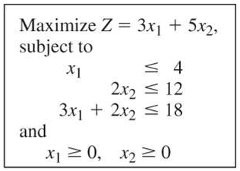
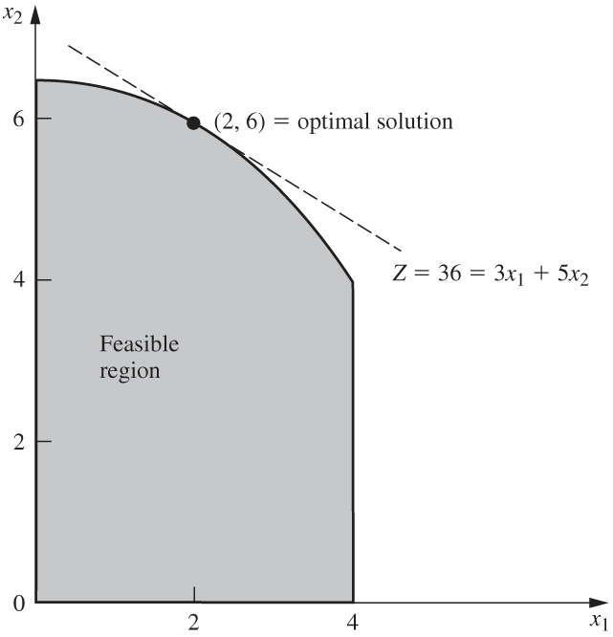
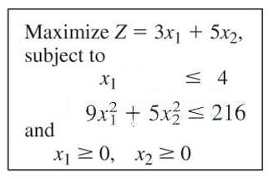
1. Graphical Illustration of Nonlinear Programming
C
C

Slide 5
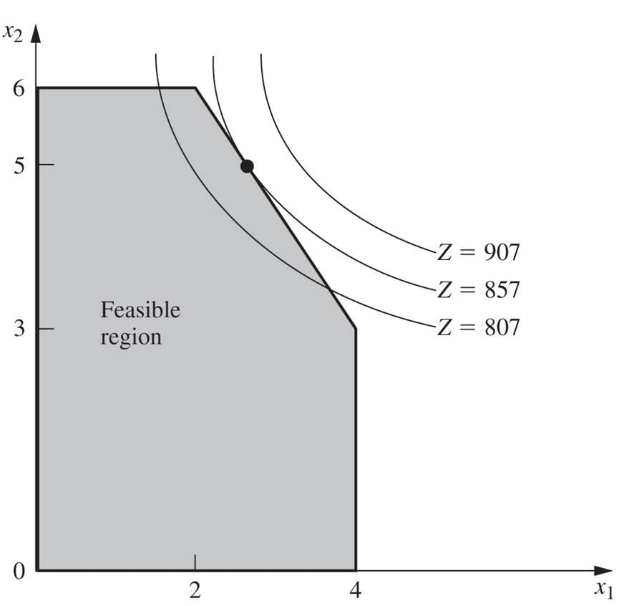
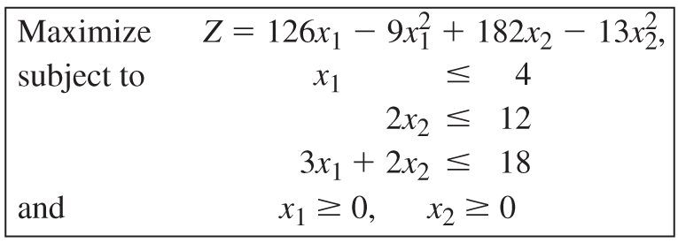
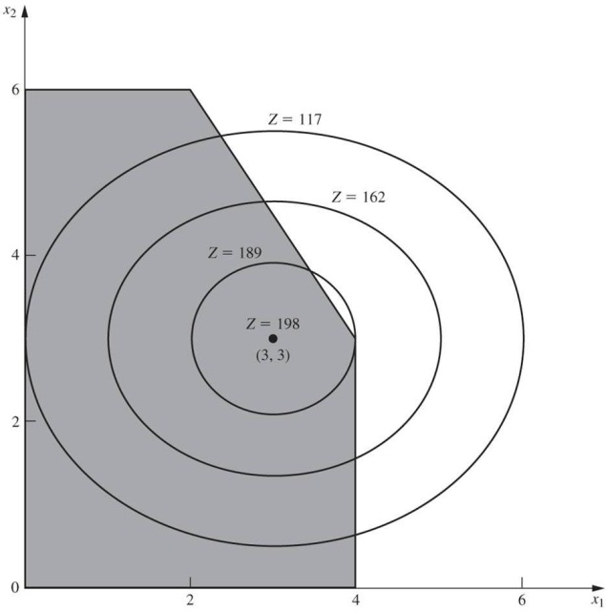
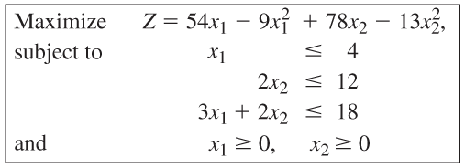
D
E

Slide 6
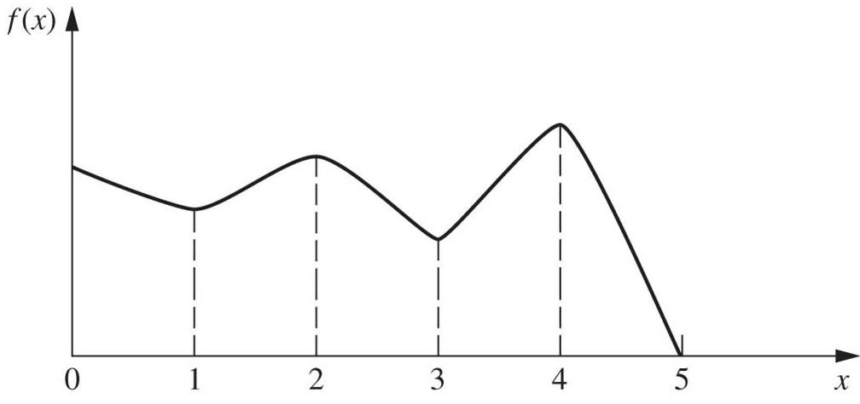
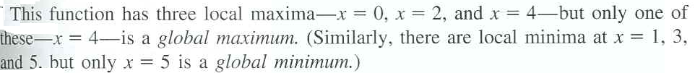
A local maximum need not be a global maximum
C
A
B
D
E
F
Nonlinear Programming algorithms generally can not distinguish between a local optimal solution and a global optimal solution.

Slide 7
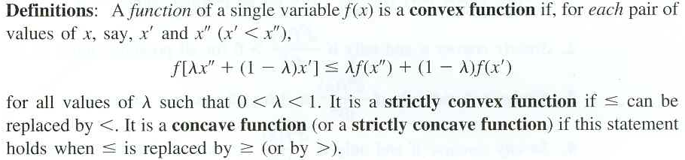
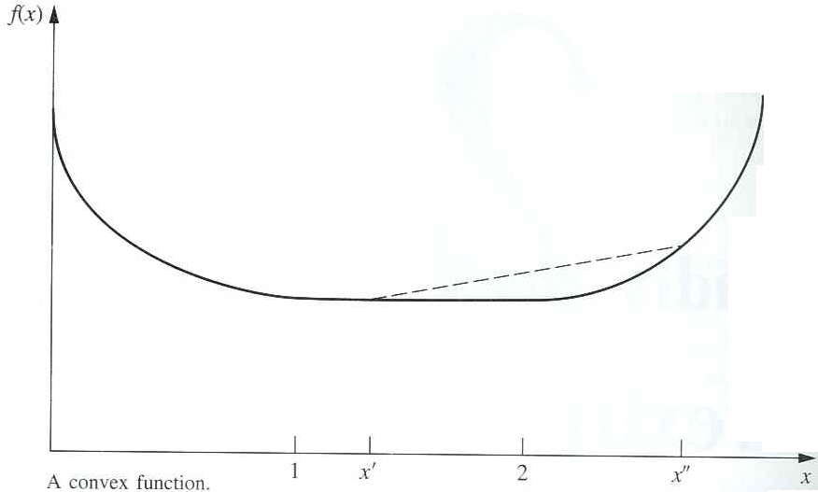
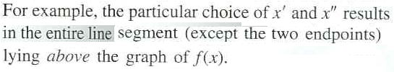





2. Convexity
Convex or concave functions of a single variable
H
B
A
L

Slide 8

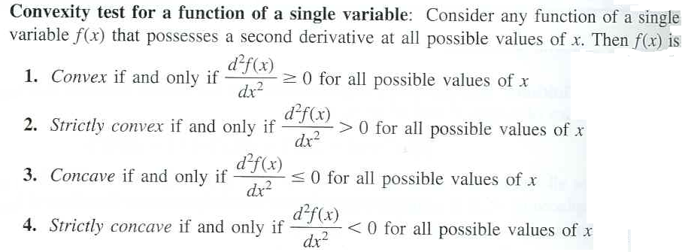
The geometric interpretation indicates that f (x) is convex if it “bend upward”.
To be more precise, if f (x) possesses a second derivative everywhere, then f (x) is convex if and only if for all possible values of x
In terms of the second derivative of the function, the convexity test is summarized below.

Slide 9
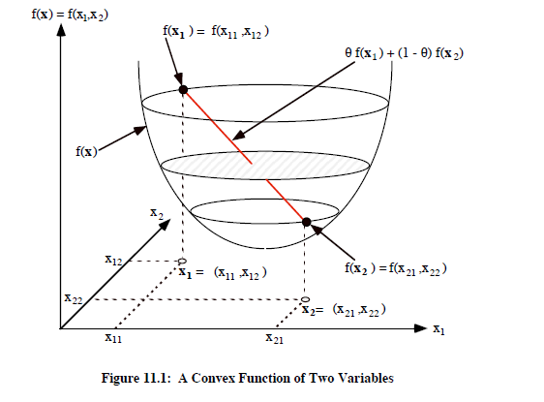

Slide 10
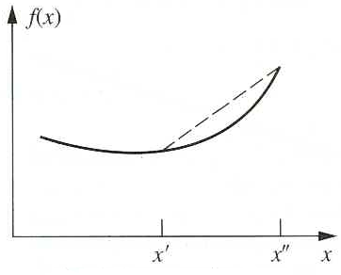
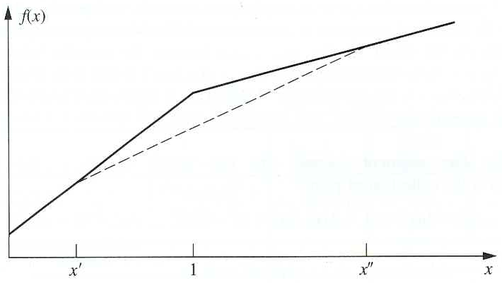
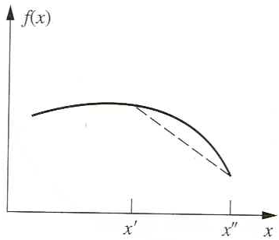
M
N
A convex function
A strictly convex function
T
A concave function
A strictly concave function

Slide 11
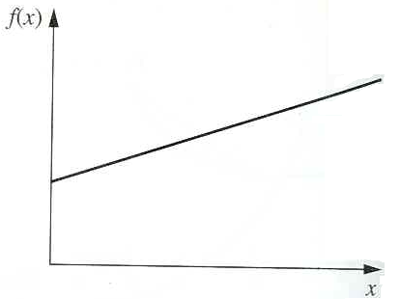
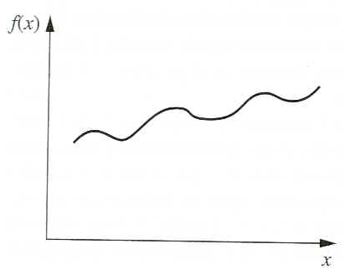
A function that is both convex and concave
A function that is neither convex nor concave

